Slide 1
The Triploblastic , Acoelomate Body Plan
Roselyn Aperocho-Naranjo
USPF, College of Pharmacy
www.roselynnaranjo.vze.com

Slide 2
Concept
The Acoelomates are represented by Phyla Platyhelminthes, Nemertea (ribbon worms), and
Gastrotricha (free-living and fresh water species.
Important characteristics include bilateral symmetry, true mesoderm, have muscles and
other organs, have nervous system – brain and spinal cord
Lack body cavity due to the filling of mesodermal mass between the epidermis and the
digestive tract
Dorsoventrally flattened animals comonly called flatworms
Parasitic and a member of Class Turbellaria
Representatives of Classes Monogenea, Trematoda and Cestidea

Slide 3
Concept
COMMON TERMINOLOGIES
Triploblastic
- have three primary germ layers
Acoelomate
- Without coelom
Mesoderm
Triploblastic
Triploblastic
Triploblastic
Triploblastic

Slide 4
Evolutionary Perspective
CHARACTERISTICS
PHYLUM PLATYHEMINTHES
Usually lattened dorsally, triploblastic, acoelomate, bilateral symmetry
Unsegmented worms
PHYLUM NEMERTEA
Incomplete gut is usually present
With anterior erebral ganglion and longitudinal nerve cords
Triplolastic, acoelomate, bilaterally symmetrical, unsegmented, ciliated
Complex reproductive organs
Epidermis contains mucous glands
PHYLUM GASTROTRICHA
Complete digestive tract with anus
Closed circulatory system
Usually lattened dorsally, triploblastic, acoelomate, bilateral symmetry
Body muscles are organized into tree layers
Unsegmented worms
Incomplete gut is usually present
With anterior erebral ganglion and longitudinal nerve cords
Complex reproductive organs

Slide 5
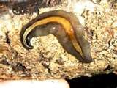
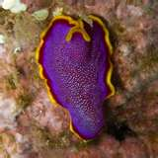
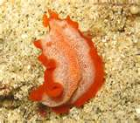
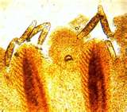
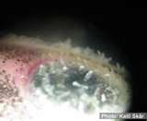
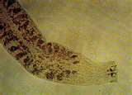
Classification
Phylum Platyhelminthes
Flatworms; Bilateral acoelomates; over 20,000 species
Class Tubellaria
Mostly free-living and aquatic; external surface are usually ciliated; mucous glands; hermaphroditic Ex. Convoluta, Notoplana, Dugesia
Class Monogenera
Monogenetci flukes; mostly ectoparasites on vertebrates; one-ife cycle form in only one host Ex. Disocotyl, Gyrodactylus, Polystoma

Slide 6
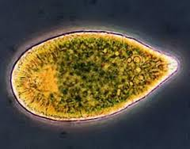
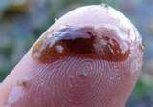
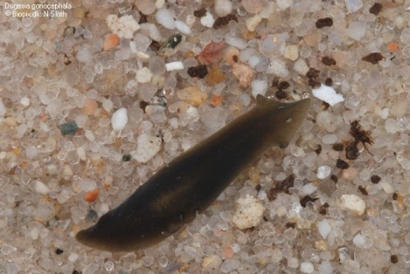
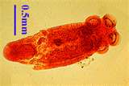
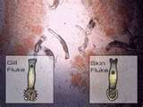
Classification
Phylum Platyhelminthes
Flatworms; Bilateral acoelomates; over 20,000 species
Class Tubellaria
Convoluta
Notoplana
Dugesia
Class Monogenera
Gyrodactylus
Polystoma

Slide 7
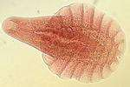
Classification
Phylum Platyhelminthes
Flatworms; Bilateral acoelomates; over 20,000 species
Class Trematoda
Trematodes; all are parasitic; have complicated life cycle involving sexual & asexual reproduction; over 10,000 species
Subclass Aspidogastrea mostly endoparasites of mollusks; no oral sucker ex. Aspidogaster, Cotylaspis

Slide 8
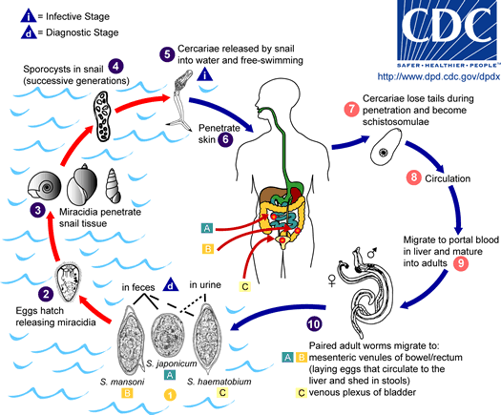
Life Cycle
Phylum Platyhelminthes

Slide 9
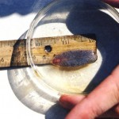
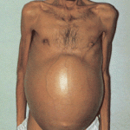
Classification
Phylum Platyhelminthes
Flatworms; Bilateral acoelomates; over 20,000 species
Class Trematoda
Trematodes; all are parasitic; have complicated life cycle involving sexual & asexual reproduction; over 10,000 species
Subclass Digenea adult endoparasites in vertebrates; two different life-cycle form in two or more hosts; have oral sucker and acetabulum ex. Schistosoma (blood fluke), Fasciola (liver fluke), Echinostoma (intestinal fluke), Gastrodiscoides (intestinal fluke), Clonorchis (Asiatic liver fluke), Dicrocoelium (liver fluke), Opisthorchis (liver fluke), and Paragonimus (lung fluke)

Slide 11
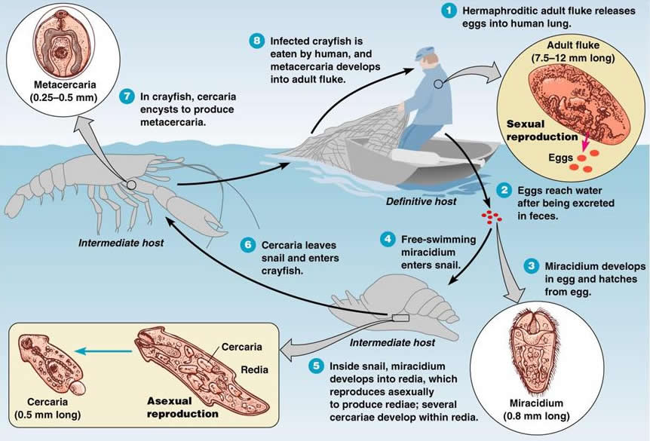
Life Cycle of Blood Fluke

Slide 12
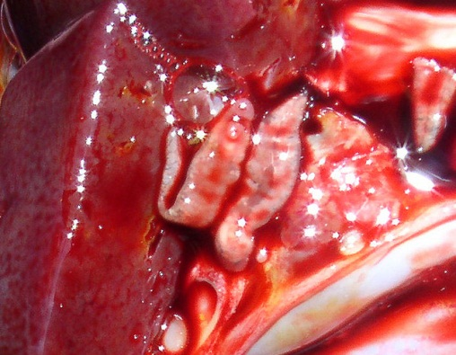
Classification
Phylum Platyhelminthes
Flatworms; Bilateral acoelomates; over 20,000 species
Class Cestoidea
all are parasitic with no digestive tract; have great reproductive potential; tapeworms and about 35,000 species
Subclass Cestodaria
Body is not subdivided into proglottids; larva in crustaceans; adult in fishes; about 15 species ex. Amphilina, Gyrocotyl
Subclass Eucestoda
True tapeworms; contains both male and female reproductive systems in each proglottids; about 1,000 species ex. Protocephalus, Taenia, Echinococcus, Diphyllobothrium

Slide 13
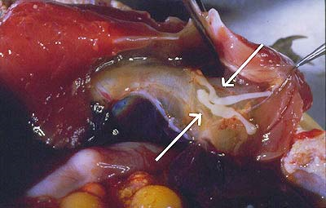
Classification
Phylum Platyhelminthes
Flatworms; Bilateral acoelomates; over 20,000 species
Class Cestoidea
all are parasitic with no digestive tract; have great reproductive potential; tapeworms and about 35,000 species
Subclass Cestodaria
Amphilina, Gyrocotyl
Subclass Eucestoda
True tapeworms; contains both male and female reproductive systems in each proglottids; about 1,000 species ex. Protocephalus, Taenia, Echinococcus, Diphyllobothrium

Slide 14
Classification
Phylum Nemertea
Flattened & elongated worms found in marine & sand;
over 900 species; commonly called proboscis worms
Mostly pale yellow, orange, green or red
Insert picture here

Slide 15
Classification
Phylum Gastrotricha
Inhabit spaces between bottom sediments; about 500 living species
Insert picture here

Slide 16
True stories
The Animal Inside Me
Insert video here

